Slide 2

Making the world a better place?
Notes:
making the world a better place. Through constructing elegant hierarchies for maximum code reuse and extensibility."
make the world a better place through Paxos algorithms for consensus protocols,
make the world a better place through canonical data models to communicate between endpoints
making the world a better place through minimal message-oriented transport layers.

Slide 3
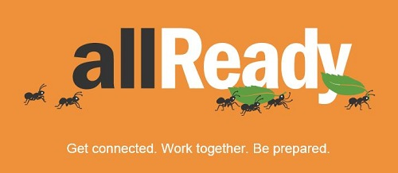
Introduction
Notes:
Does try to make the world a better place
supporting disaster relief organizations with open source software
Creating apps that map the spread of disease
Maintaining software that helps to optimize the delivery of relief supplies And more – No need to strat all over when time is criticall
Donate what you are good at – waste for programmers to paint fenses…

Slide 4
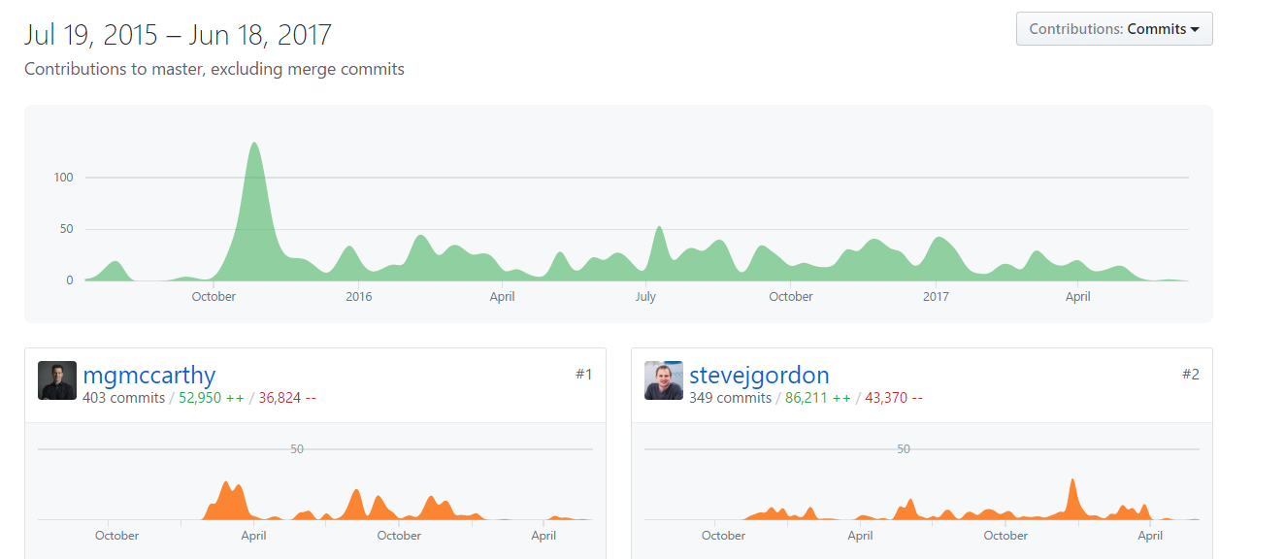
Active
Notes:
sub project of Humanitarian Toolbox.
Active project

Slide 5
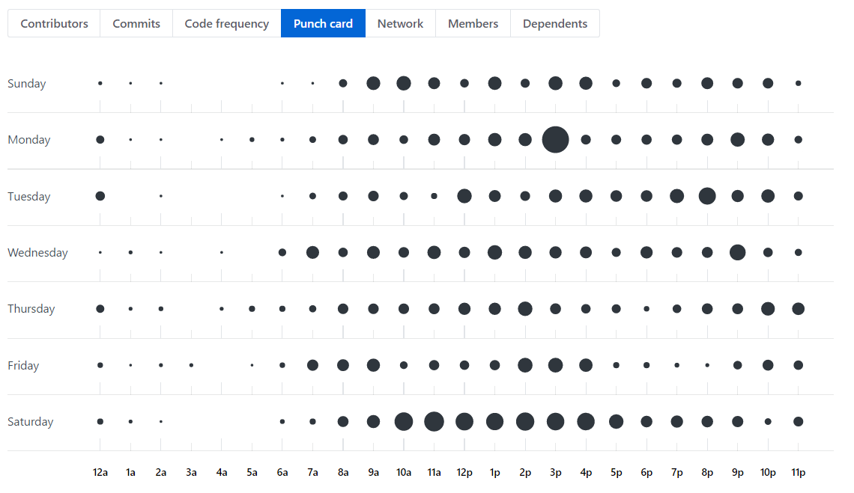
Active
Notes:
Mostly on free time?

Slide 6
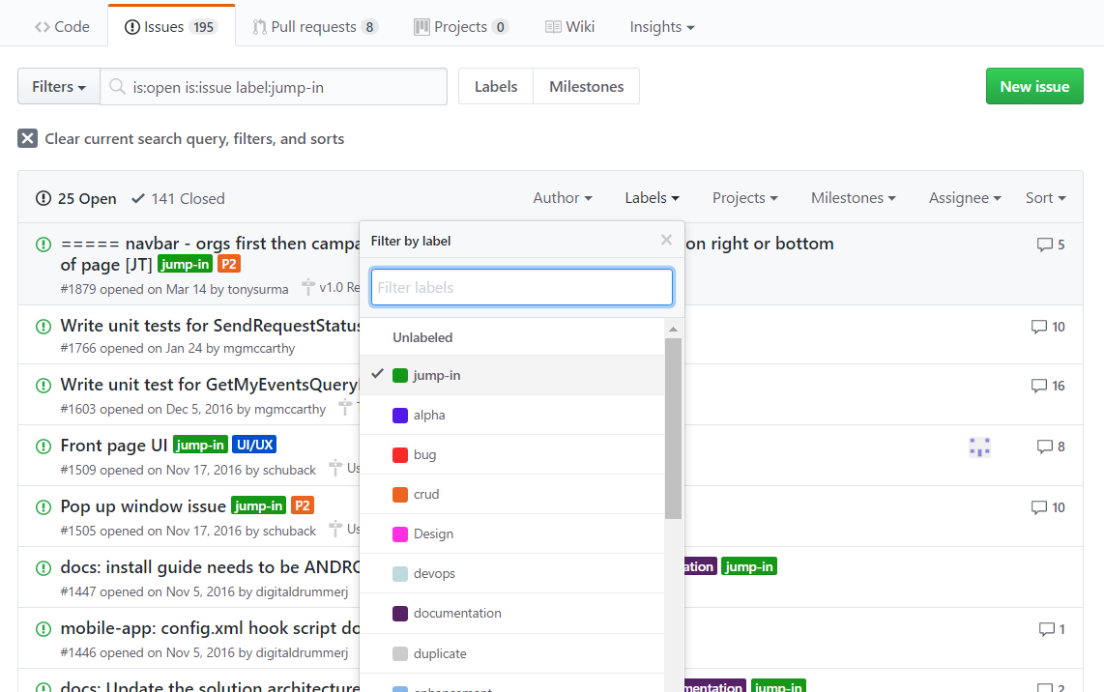
Active
Notes:
Has special for first time contributors for open source

Slide 7
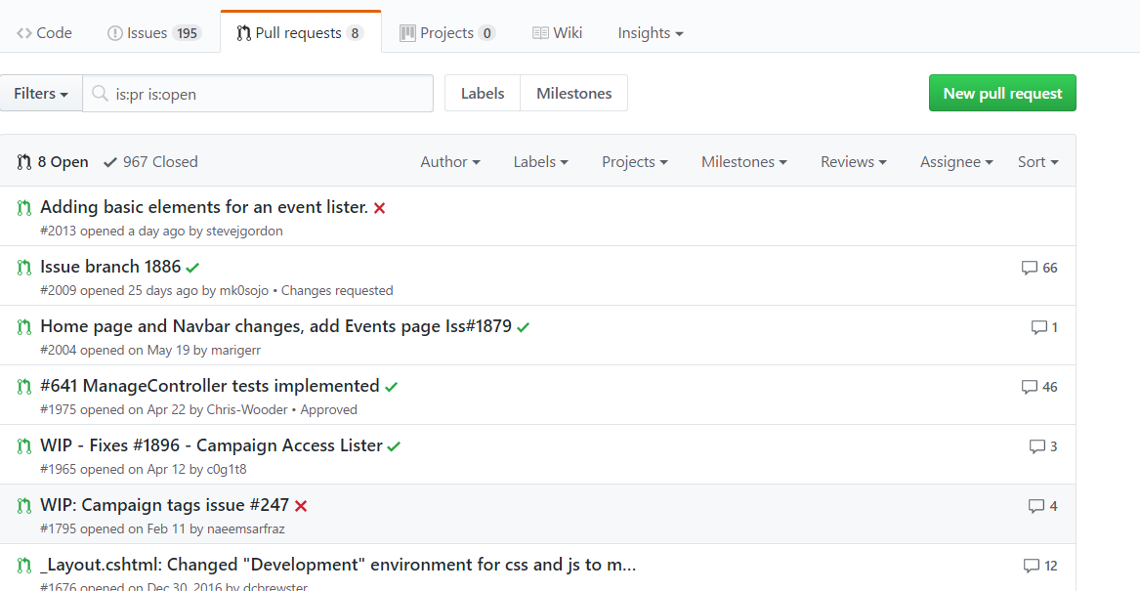
Active
Notes:
Has pull requests

Slide 8
Architecture - This a place holder ###
Cloud services
The allReady web project is designed to be hosted in Microsoft Azure. The following services are used by this application when running in Azure:
App Service Web Apps: hosts the web application.
SQL Database: storage of relational data.
Storage: storage of uploaded BLOB data.
Authentication
Authentication of web site mobile app users leverages OAuth 2.0 with credentials from external authentication providers such as Facebook, Twitter, Google or Microsoft. Users can use their existing social media accounts to sign into the web site or mobile app. For more information, see Enabling authentication using external providers.
Cross-platform mobile app

Slide 9
Changeability
Robustness over quick cycles of delivery
Standardization
How changing the DB is handled(using EF Core migrations)
Work with git
Testing UI changes (using Canopy)
Validating code correctness using ver 1000 unit tests.
CI using AppVeyor
Every pull request triggers a CI build (compile and run unit tests). This workflow gives more confidence that the code being merged to master isn't breaking anything.
Notes:
At list as pen & paper
clear policies and guide lines for the above
It seems that the main reason to go with AppVeyor was the existing skillsets of contributors.

Slide 10
Evolution required Qualities
_ Requirement _ | _ How Met _
_ 1. The app must be easy to maintain cross-platform _ | The app is built using Xamarin – thus ensuring having maximum of shared code between multiple platforms
_ 2. Avoid database update conflicts _ | Updates to the database are done using EF Core migrations. Before creating a pull request – it should be tested on a clean checkout of master branch.

Slide 11
Availability and Resilience
_ Requirement _ | _ How Met _
_ 1. There should be no single point of failure _ | The service is hosted By Azure which offers distributed and scalable services.
_ 2. The service must be available on demand in times of need _ | To avoid the overhead of a full deployment chain – the service is hosted by Azure. This allows the service to be up constantly on one hand and avoiding the price of maintaining a server on the other hand (using auto-scale provided by Azure)
_ 3. New contributions should not brake old features _ | _There is a test suit that contains over 1000 tests. Contributors are encouraged run them and new ones for any new contribution. Every pull request triggers a CI build (compile and run unit tests). This gives more confidence that the code being merged to master isn't breaking anything.
_ 4. The service should function also when there is no reliable internet connection _ | Messages are being using "post" _(rather than "get") for utilizing connection while available – even for a brief moment. In addition – the cellular network is being used as well for sending messages.

Slide 12
Summary
Guides & Getting involved
You can get involved in the following areas: Individual / Technology / Government Agency / Private Sector / NGO and Non-Profit / Other
Volunteer Sign-up page
Setup guide for developers SDKs supporting .Net / Linux / Mac OS X
Software instal Includes: General Install Steps Getting the Source Code Web Solution Running Test Cases Mobile Solution
Work with Git Assuming you've already installed Git, but don't know how to use it yet.
Notes:
allReady (& Humanitarian Toolbox) is a project dedicated for contributing to the community preparing for and while disasters situations using skills developers have.
challenges
that are uncommon for a software project (taking in consideration unstable environment like - no reliable internet connection)
while the mission of the software might be vital,
as well as common open source challenges (e.g. keeping quality of code base with over 100 contributors - all volunteers).
Facing those challenges
(taking advantage of SMS for communication, sending sparse messages when opportunity is available, push etc...)
and standardization solutions (detailed guides for contribution, unit & UI tests, CI).
Most of the time writing this chapter was spent on collecting information from varies sources and trying to put it together
did not find a self-contained source overviewing the project from an architecture / meta point of view I am not sure to what extent the data we have collected is correct / full.

